Slide 1

BSAN 460 Senior Project
SENTIMENT ANALYSIS
How public opinions affect stock performance
Group 2: Andrea Ngo | Vinh Nguyen | Tram Le | Paige Powell | Nhat Ha Nguyen

Slide 2
SENTIMENT ANALYSIS
STOCK MARKET TWEETS
Overview &
Business Objectives
Data Visualization & Processing
Methods
Lexicons
Machine Learning Classification: Random Forest
Further Modelling & Conclusion
Group 2: Andrea Ngo | Vinh Nguyen | Tram Le | Paige Powell | Nhat Ha Nguyen

Slide 3
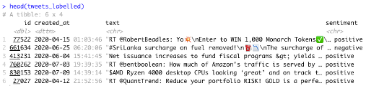
DATASET
Data Overview
4 columns
ID: Contains id used for the tweet.
Created at: Date and time when the tweet was tweeted.
Text: Tweet/text written by the user.
Sentiment: Whether the tweet was positive, negative or neutral.
Notes:
Plotting the distribution of target variable

Slide 4
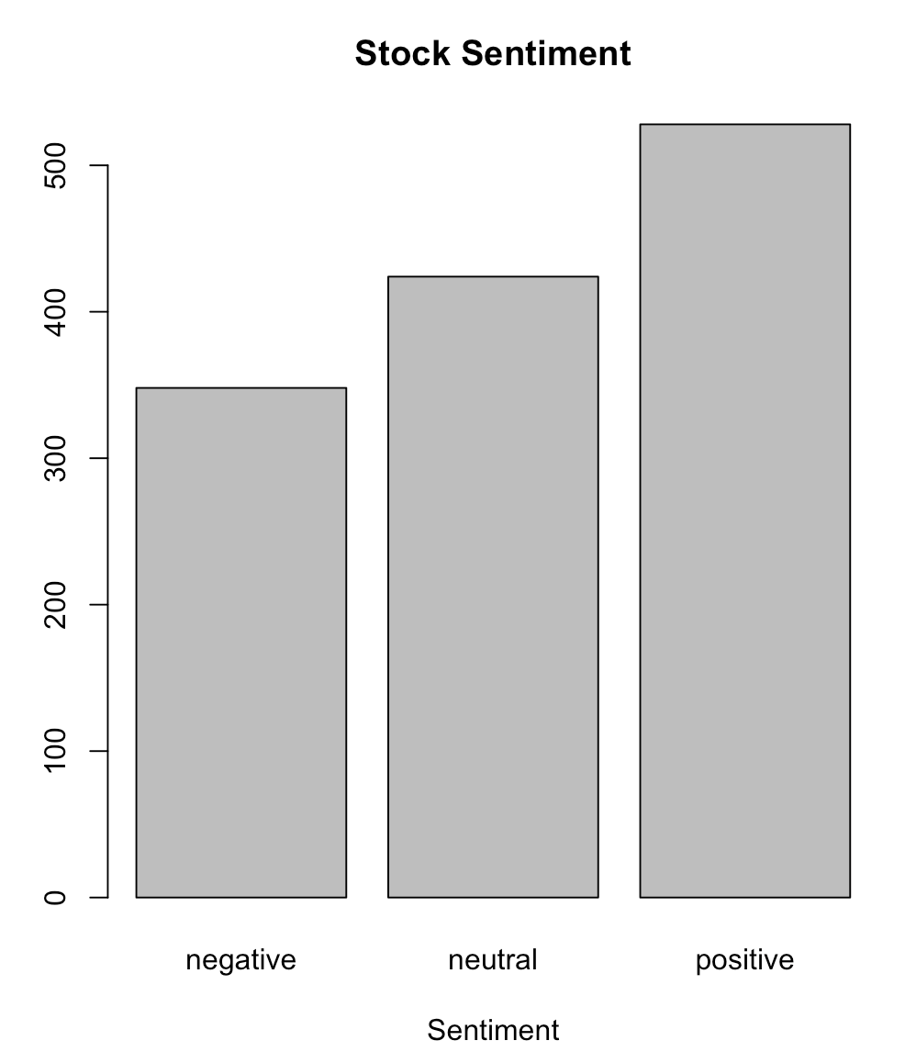
DESCRIPTION
Tweets were collected between
April 9 & July 16, 2020.
Data collection method: used SPX500 tag, top 25 companies tag in the index and "#stocks”
5,000 tweets in total:
3,700 tweets are unlabeled
1,300 were manually labeled & reviewed
More than 500 positive sentiments,
about 350 negative, and more than 400 neutral.
Data Overview
Distribution of target variable graph
Notes:
Plotting the distribution of target variable

Slide 5
QUESTION
Does Twitter tweet opinions of the stock market have an impact on stock sentiments?
Business Questions
OBJECTIVE AND DESIRED RESULTS
Use Lexicon-based Sentiment Analysis techniques and other classification models to discover patterns in the Tweet data.
Make predictions based on intricate patterns for answering business questions.

Slide 6
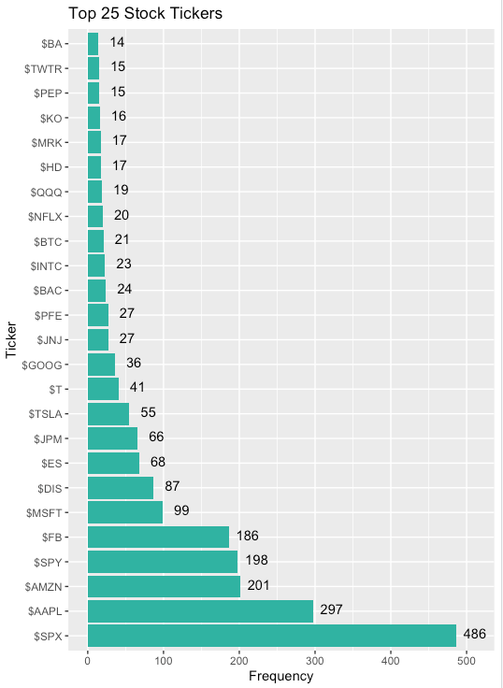
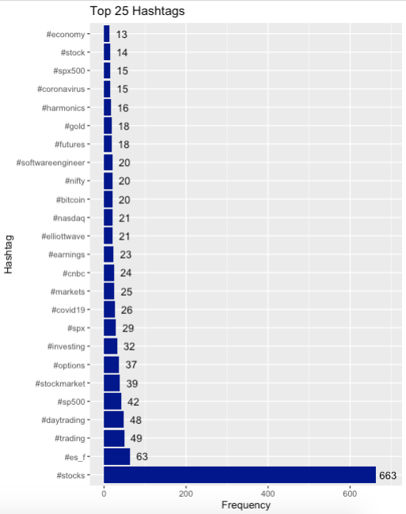
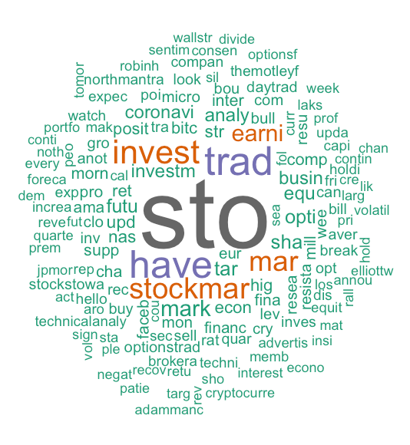
Visualization

Slide 7
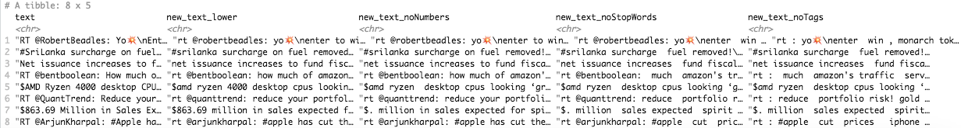
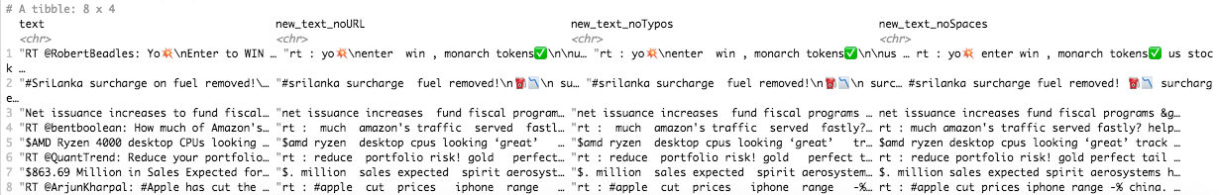
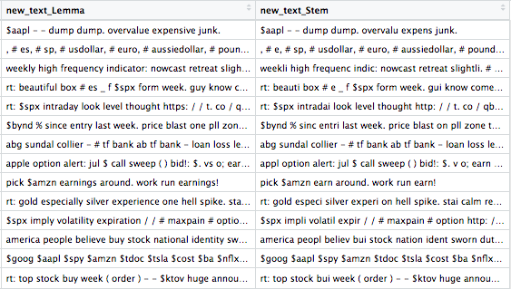
Transform to lower cases and remove: numbers, stop words, tags, URLs & white spaces
Text-
Processing
TO BE CONSIDERED
Remove punctuations
Remove all except “$” and “#”
Applied lemmatization and not stemming

Slide 8
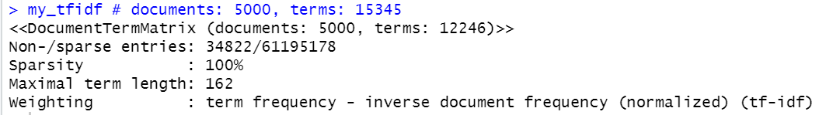
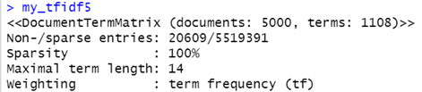
First we created a Tf-Idf using the following code:
my_tfidf <- DocumentTermMatrix(corp, control = list(weighting = weightTfIdf))
Tf-Idf
Dimension reductions
Transforming the Tf-Idf into a dataframe
stock_data_frame <- as.data.frame(as.matrix(my_tfidf_small))

Slide 9
LEXICON
Compare between 3 dictionaries
Bing
Loughran
Affin
Compare 3 dictionaries to calculate lexicon scores per document per word
Remove neutral sentiments to accurately forecast future tweets sentiment (876 after removing neutral vs 1300)
Better general performance
Easier to predict 2 classes vs 3 classes
Text Mining Method
Notes:
Tram
876 after removing neutral vs 1300, making our sample size a lot smaller, would potentially make the result not 100% accurate

Slide 10
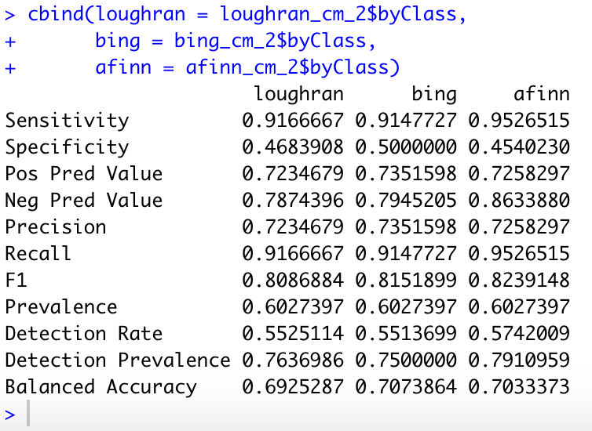
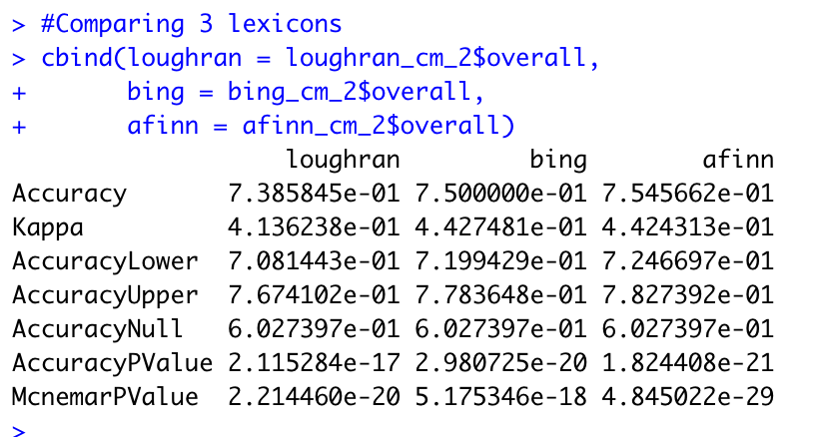
LEXICON
When compare all 3 dictionaries the model shows:
Accuracy: 73%
Sensitivity: 90%
Specificity: 45%
F: 80%
Text Mining Method
Notes:
Tram
Above average accuracy
better at predict positive than negative
has a good goodness of fit

Slide 11
RANDOM FOREST: BASE MODEL
Rationale for picking Random Forest
Categorical Variables
Visualization
Robust Machine Learning Classification Method
Data Preprocessing
No Missing Values
Data Partition: split dataset into 85/15 training & testing data
Text Mining Method
Notes:
categorical variable
visualization for interpretability
robust: handle noise, irrelevant/redundant features,

Slide 12
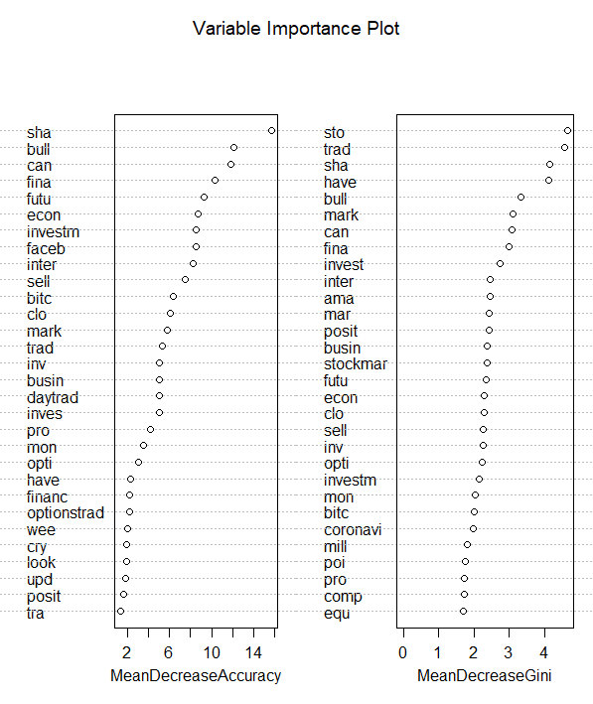
RANDOM FOREST: BASE MODEL - VARIABLE IMPORTANCE
Text Mining Method

Slide 13
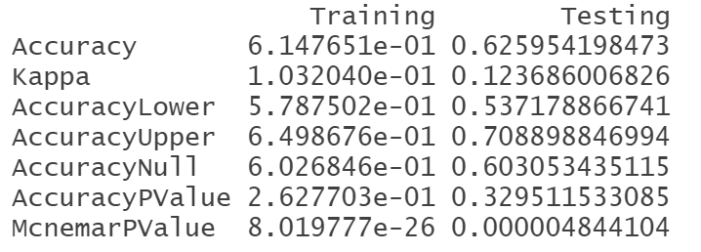
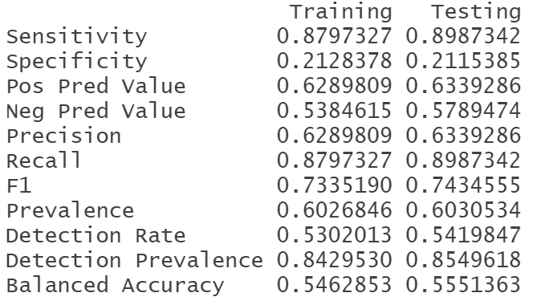
RANDOM FOREST: BASE MODEL
Our RF model is much better at predicting the positive class
Accuracy and Kappa is not as expected
Accuracy: just better than random guess (50%)
Kappa: Poor to no agreement
GOODNESS OF FIT
Not overfitting or underfitting
Text Mining Method

Slide 14
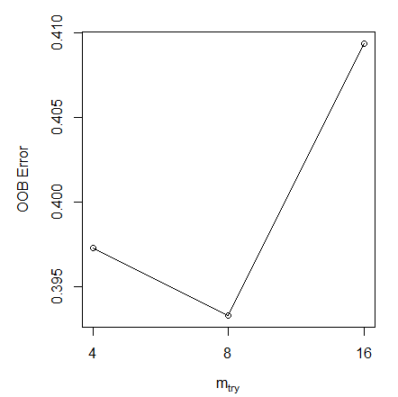
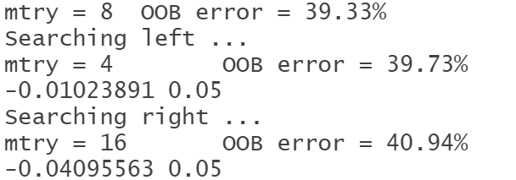
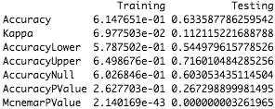
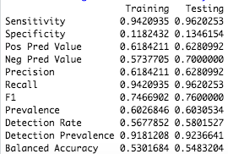
RANDOM FOREST: HYPERPARAMETER TUNING
Result isn’t desirable but not too bad
Accuracy: 61%
However, tuned RF gave the best result comparing to others
Text Mining Method
GOODNESS OF FIT
Balanced model across 2 sets
Model better predicts the “positive” than “negative” class
Sensitivity (true positive rate): 94%
Specificity (true negative rate): 12%
Model has a fair goodness of fit
F-measure: 75%
Notes:
Number of variables available for splitting at each tree node

Slide 15
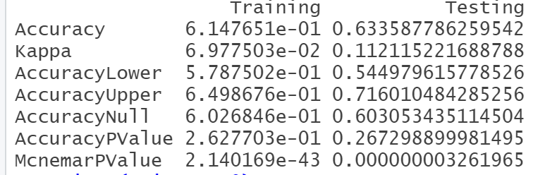
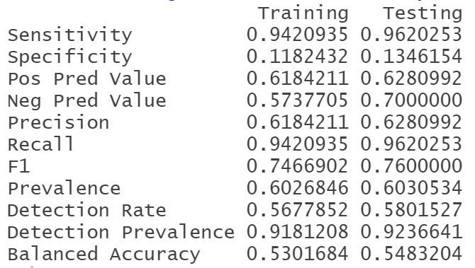
RANDOM FOREST: FEATURE SELECTION
MODEL-BASED METHOD:
Extracting the top 20 variables based on Gini Index
These variables will be used as predictors for our model
Performance is stagnant
Text Mining Method

Slide 16

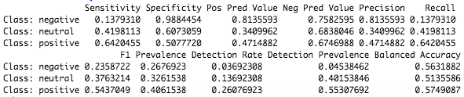
FURTHER MODELLING: RF Probability Calculation
Keep all the 3 classes in the testing data since removing all “neutral” rows made our sample size too small (876 obs. compared to 1300 obs.)
type = “prob”
CHOOSING THRESHOLDS: Categorize the prediction when the probability of “positive” class falls under certain thresholds
Further
Modelling
0-25%: Negative
25%-85%: Neutral
85%-100%: Positive
COMPARING TO ORIGINAL LABELLED SENTIMENTS
Due to 3 classes in target variable, performance can’t be as good as the tuned model with 2 classes
Notes:
RF probability calculation
removing all neutral rows made our sample size smaller, from 1300 down to 876 obs. therefore, we want to test on the original testing set with 3 classes to see how it compares to our RF model with 2 classes
Thresholds
from the result we got, which is the first 3 columns in the table in the middle, we want to categorize the tweets into 3 classes
after a few trials, we found the best thresholds as seen.
If prob of positive falls…..
Comparison
Lastly, we want to compare with the original labeled data
as anticipated, the perf is worse due to 3 classes in target variable as compared to 2
poor perf is shown through Accuracy, Sensitivity, Specificity, and F1
# As anticipated, due to the 3 classes in the target variable, the performance can't be as good as the base
#model.

Slide 17
BUSINESS QUESTION: Do public opinions affect stock sentiments?
With this sample size, we recommend using lexicon model (highest accuracy of 75%)
Our tuned Random Forest did predict that public opinions have an impact on positive stock sentiments, and potentially stock prices.
Conclusions:
Investors should only use this model as a reference to their decisions
of buying into those mentioned stocks that have positive opinions.
Be aware that accuracy of 61% is only fair.
Conclusion
& Re-
commendation
RECOMMENDATIONS
Collect more input of the negative class (i.e negative sentiments) so the model can make better predictions
With a more accurate model, we can compare the sentiments with the stock prices in the same period
Vector Space Model instead of Tf-Idf as the input for our models
Google’s BERT pre-trained model
Notes:
VSM takes into account the relationship between data as represented by vectors

Slide 18
BSAN 460 Senior Project
STOCK MARKET TWEETS - SENTIMENT ANALYSIS
THANK YOU!
Group 2: Andrea Ngo | Vinh Nguyen | Tram Le | Paige Powell | Nhat Ha Nguyen

